Slide 1
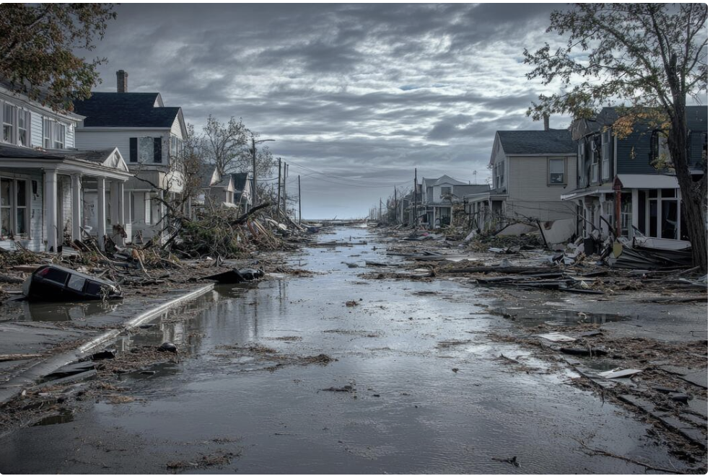
Hurricane Sandy
By: Patrick, Tyler, Bennett, and Jake
Group 6

Slide 2
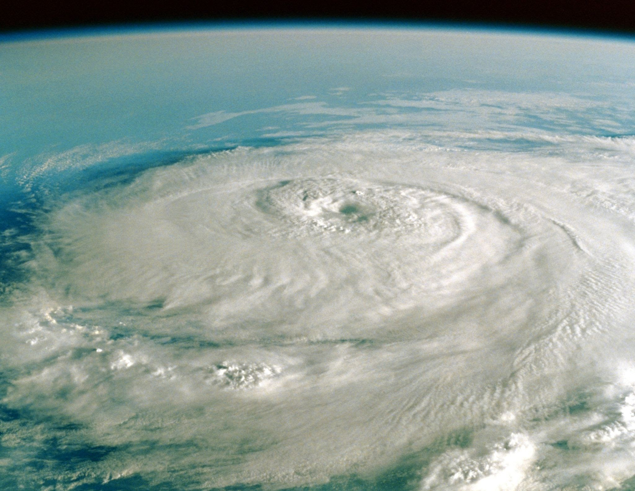
Overview
Topic: Hurricane Sandy (2012)
Largest Atlantic Hurricane to make landfall
Worse than people expected
Severe damage to Jamaica, Haiti, Cuba, Puerto Rico, etc…
Impacted 21 states, especially New York and New Jersey

Slide 3
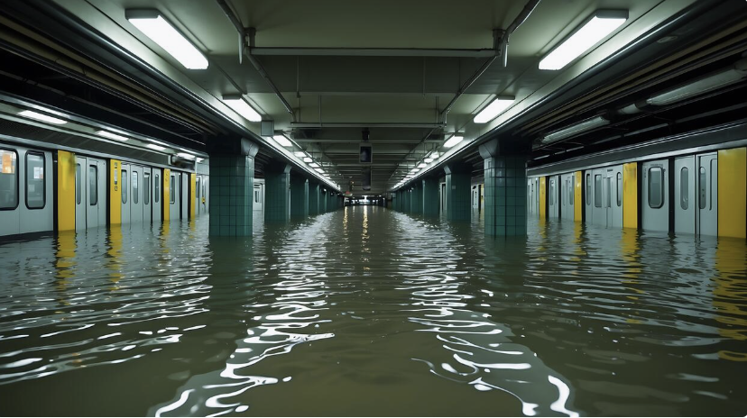
Hurricane Sandy, explained
Nationalgeographic.com
New York and New Jersey were especially hard-hit, with flooding in NYC, destruction along the Jersey Shore, and 8 million people losing power.
70 billion in damages (fourth most expensive storm in U.S. history)
  600,000 units destroyed between NY and NJ
Showed signs of outdated infrastructure and lack of flood insurance.
Bias: Ease of Recall
  Estimated event based on vividness and recent memory
  Led to people not being as prepared
  Underestimated risks when given warnings
Notes:
Mention Hurricane Irene - less severe than people thought
Mention how this was irrational judgement

Slide 4
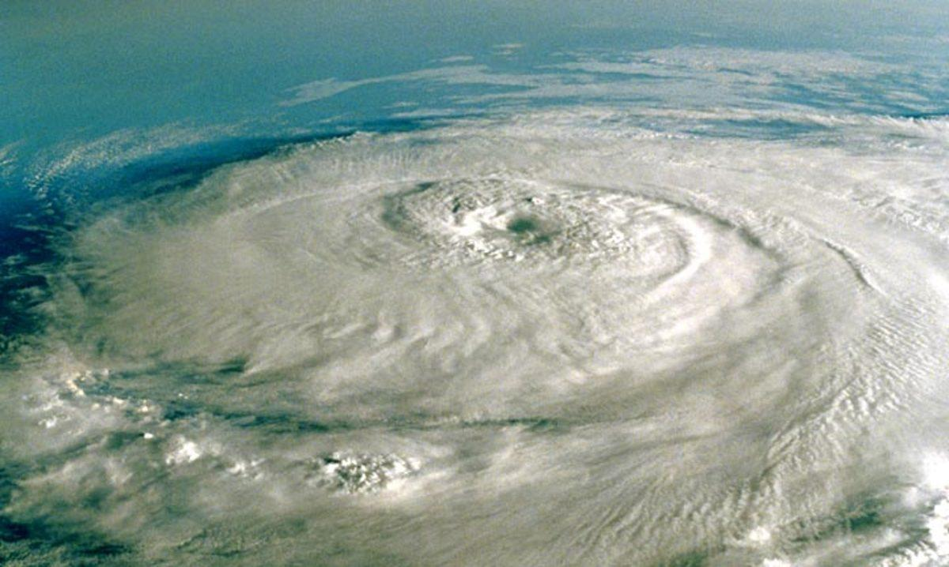
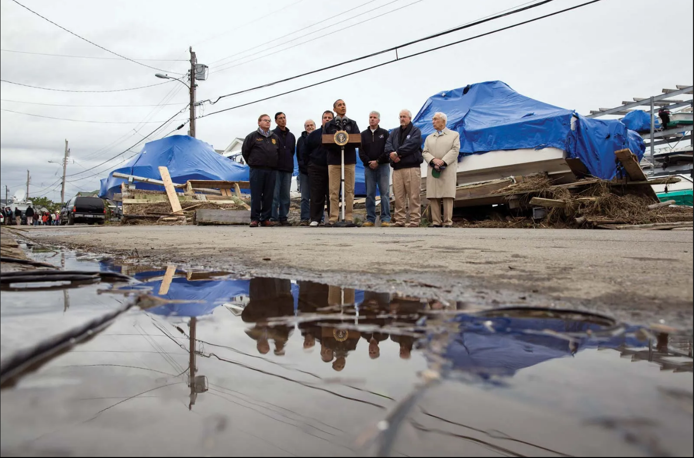
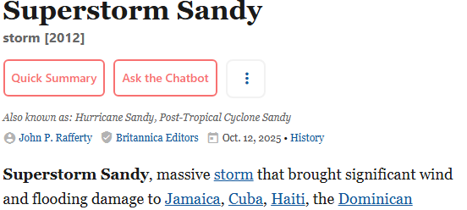
Super Storm Sandy
Sandy was emphasized as a massive or a superstorm compared to other storms
Destroyed over 900 miles of land and $70 billion in damages to property
Confirmation Bias: article confirmed a lot of prior beliefs of people from before the storm, sea walls and poor infrastructure in buildings not capable of handling the storm.
Anchoring Bias: SUPERSTORM SANDY
Notes:
https://www.britannica.com/event/Superstorm-Sandy

Slide 5
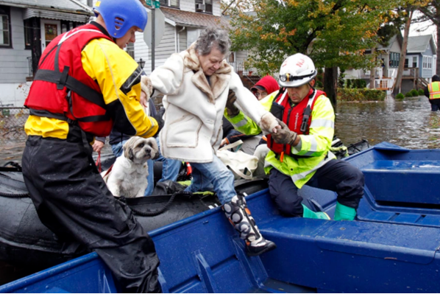
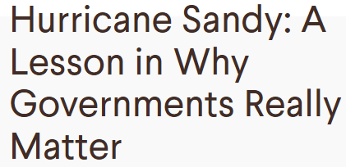
Why Governments Really Matter
Highlights what tax payer dollars could of been used on before the storm (Hurricane Tracking NOAA)
Framing Bias: the article framed the government to be seen as helpful throughout all aspects of the storm.
Anchoring Bias: Ties in with Framing Bias and “A Lesson in Why Governments Really Matter”
Notes:
https://www.cfr.org/blog/hurricane-sandy-lesson-why-governments-really-matter

Slide 6
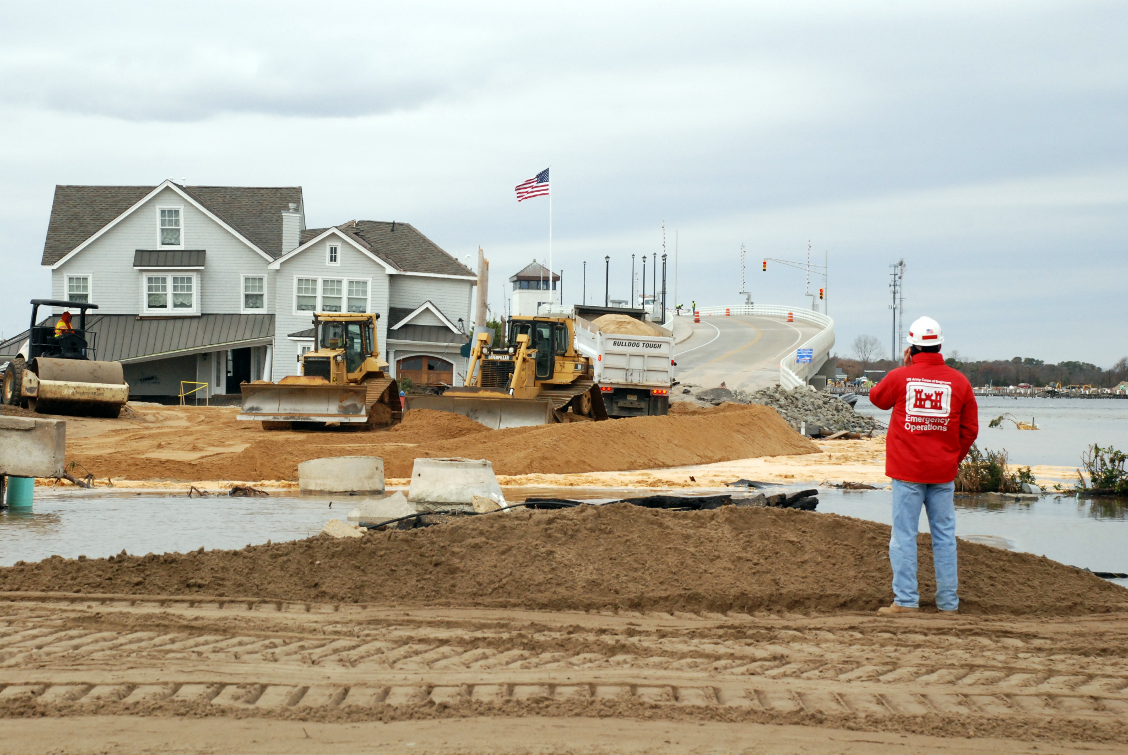
Hurricane Sandy Rebuilding Strategy
Hurricane Sandy Rebuilding Strategy (HUD, 2013)
Federal long-term recovery plan after Hurricane Sandy(mainly for NY & NJ)
Focused on restoring communities and improving resilience against future climate events
Biases present
Overprecision
  “The Task Force will work hand-in-hand with communities to help them rebuild smarter and better by providing the best data about the risks they face”
https://hcr.ny.gov/system/files/documents/2023/08/h_s_rebuilding_strategy.pdf
Notes:
“This report was created by the federal task force after Hurricane Sandy, and it became the main plan for how the government wanted to rebuild over the long term. It wasn’t just about fixing damage, but the also wanted to update housing, infrastructure, and coastal protection so communities would be better prepared for future storms.” “It’s a primary government source, meaning it comes straight from the agencies that were actually in charge of the recovery. On paper it sounds very organized and confident, but when you look closer, there are several decision-making biases in the way they describe the plan. The first one is overprecision.”
“So the first bias here is overprecision, which basically means being way too confident in your data or predictions. In this strategy, the Task Force talks like they have almost perfect information and that everything will run smoothly. But after a major storm, the data is never perfect, and different government agencies rarely move at the same pace.”
“We can see this in what actually happened: the government expected recovery to move quickly, but five years later only about 60% of major projects were finished. That gap between what they expected and what actually happened is a clear sign of overprecision.”

Slide 7
Biases Present(Cont)
Bounded Awareness
Planning Fallacy
Framing Effect
“Priority should be given to projects that demonstrate clear community benefits and support immediate recovery needs.”
“We are working to accelerate the recovery process and restore normalcy to neighborhoods as quickly as possible.”
“This Strategy represents an opportunity to build back stronger, smarter, and more resilient communities than ever before.”
Focused on visible short-term projects
Less attention slower recovering/ vulnerable communities
Overly optimistic recovery timelines
Ignored historical patterns of long disaster recovery
Framed recovery as guaranteed success
Shaped public perception early on
Notes:
Bounded Awareness : “This quote shows bounded awareness because leaders focused on fast, visible projects that looked good immediately. But that narrow focus meant less attention went to communities that were slower to recover. For example, more than 80% of rebuilding funds in New York went to coastal areas, while over 15,000 homeowners were still waiting for financial help three years later.”
Planning Fallacy: “This quote reflects the planning fallacy because the report assumes recovery could move ‘as quickly as possible.’ Historically, big storms always take longer than expected — Katrina rebuilding took over ten years in some neighborhoods. Sandy was similar: the government expected major projects done by 2016, but full recovery didn’t happen until around 2020, and costs increased from $50 billion to over $65 billion.”
Framing Effect: “This is the framing effect because the strategy describes the storm as an ‘opportunity’ to build back stronger. That language makes the recovery sound more controlled and positive than it actually was. In reality, only 30% of damaged homes were rebuilt within the first year, and public approval dropped from 70% to 43% once progress slowed.”
Focused on visible short-term projects rather than vulnerable or slower recovering communitie
Led to uneven distribution of recovery resources and left neighborhoods unprotected for future storms
Predicted quick progress based on optimistic timelines
The idea of “restoring normalcy… as quickly as possible” ignores historical evidence showing recovery from major storms takes years, not months.
Presents rebuilding as a guaranteed success, framing optimism before results were known
Influenced public perception that the government was fully in control of the recovery
“A good example of this is Hurricane Katrina in 2005. The government originally expected to rebuild New Orleans within a few years, but even a decade later, parts of the city were still recovering. Many neighborhoods took over ten years to restore basic housing and infrastructure. That shows how common it is to underestimate recovery time — a clear example of the planning fallacy.”

Slide 8
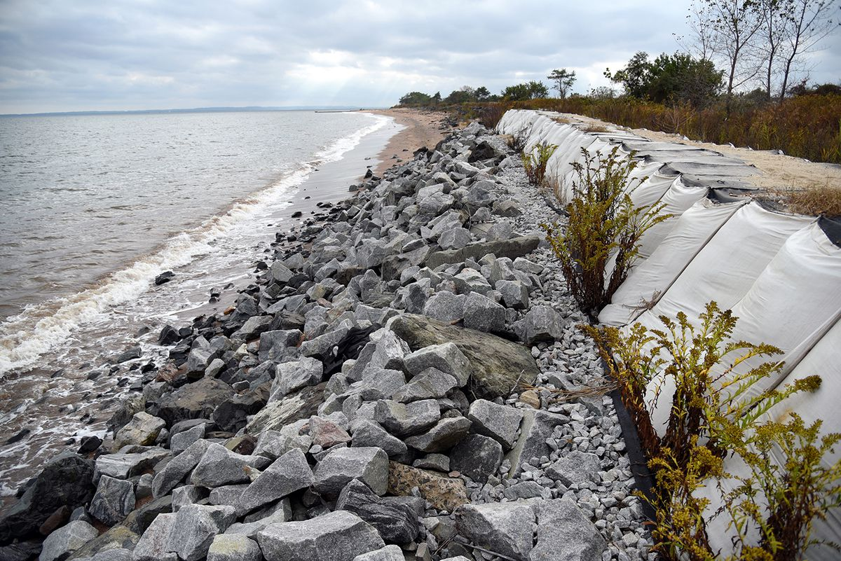
Mitigation Assessment Team Report
Landfall October 29th, 2012 in Brigantine NJ (massive post control cyclone)
Flooding exceeded the 1% annual chance flood level in many areas
Low, Mid, and High homes experienced erosion
  Damage to electrical, plumbing, and mechanical systems
Abodes should be lifted at least 2 feet front the ground, systems should be flood proofed
Bounded Awareness: Focalism
  Focused emotionally on short-term recovery and visible damage after the storm
  Overlooked long-term emotional, financial, and community recovery challenges
  Underestimated how prolonged disruption would affect residents’ well-being
Notes:
https://www.govinfo.gov/content/pkg/GOVPUB-HS5_100-PURL-gpo110213/pdf/GOVPUB-HS5_100-PURL-gpo110213.pdf

Slide 9

Politicians link Sandy’s severity to climate change.
Scientists describe it as a rare storm alignment, not directly caused by climate change.
Some acknowledge warmer oceans may have intensified the storm.
Biases:
Framing Bias: Headline frames the issue as a conflict between science and politics, distracting from the scientific complexity of the storm.
Confirmation Bias: Highlights views disputing climate change’s role while ignoring evidence that warmer sea temperatures and rising sea levels can intensify storms.
Notes:
https://www.foxnews.com/science/scientists-dispute-politicians-claims-that-global-warming-grew-sandy

